Slide 1
DIYALA UNIVERSITY COLLEGE OF ENGINEERING DEPARTMENT OF COMMUNICATION ENGINEERING
Electronic Circuits II
Second Year. Lecture 6
lecturer
Wisam Hayder
2021

Slide 2
Transistor Tuned Amplifiers
Distinction between Tuned Amplifiers and other Amplifiers
We have seen that amplifiers (e.g., voltage amplifier, power amplifier etc.) provide the constant gain over a limited band of frequencies i.e., from lower cut-off frequency $f_{1}$to upper cut-off frequency $f_{2}$. Now bandwidth of the amplifier, BW = f2 − f1.
The difference, that tuned amplifiers are designed to have specific, usually narrow bandwidth. See Fig. 15.2.
Note that ${BW}_{S }$ is the bandwidth of standard frequency response while ${BW}_{T }$is the bandwidth of the tuned amplifier.
In many applications, the narrower the bandwidth of a tuned amplifier, the better it is.
Notes:
aaa

Slide 3
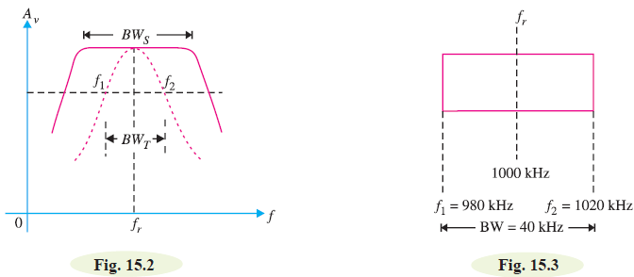
Transistor Tuned Amplifiers
Notes:
aaa

Slide 4
Transistor Tuned Amplifiers
Analysis of Parallel Tuned Circuit
A parallel tuned circuit consists of a capacitor C and inductor L in parallel as shown in Fig. 15.4 (i).
In practice, some resistance R is always present with the coil.
If an alternating voltage is applied across this parallel circuit, the frequency of oscillations will be that of the applied voltage.
Notes:
aaa

Slide 5
Transistor Tuned Amplifiers
However, if the frequency of applied voltage is equal to the natural or resonant frequency of LC circuit, then electrical resonance will occur.
Under such conditions, the impedance of the tuned circuit becomes maximum and the line current is minimum.
The circuit then draws just enough energy from a.c. supply necessary to overcome the losses in the resistance R.
Notes:
aaa

Slide 6
Transistor Tuned Amplifiers
Parallel resonance
A parallel circuit containing reactive elements (L and C ) is resonant when the circuit power factor is unity i.e. applied voltage and the supply current are in phase.
The phasor diagram of the parallel circuit is shown in Fig. 15. 4 (ii).
The coil current $I_{L}$ has two rectangular components viz active component $I_{L}\cos{{\text{φ}}_{L}}$ and reactive component $I_{L}\sin{{\text{φ}}_{L}}$ .

Slide 7
Transistor Tuned Amplifiers
This parallel circuit will resonate when the circuit power factor is unity. This is possible only when the net reactive component of the circuit current is zero i.e.
Resonance in parallel circuit can be obtained by changing the supply frequency. At some frequency fr (called resonant frequency), $I_{C}$= $I_{L}$ sin ${\text{φ}}_{L}$ and resonance occurs.
Notes:
aaa

Slide 8
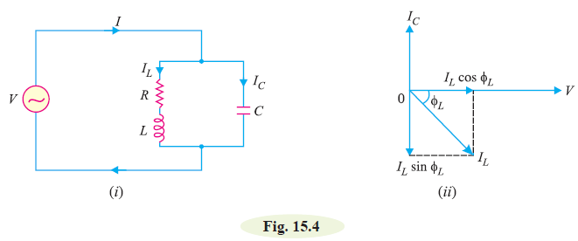
Transistor Tuned Amplifiers
...(ii)
...(iii)
Notes:
aaa

Slide 9
Transistor Tuned Amplifiers
The resonant frequency will be in Hz if R, L and C are in ohms, henry and farad respectively.
Note. If in the problem, the value of R is given, then eq. (ii) should be used to find fr. However, if R is not given, then eq. (iii) may be used to find fr.
Notes:
aaa

Slide 10
Transistor Tuned Amplifiers
Characteristics of Parallel Resonant Circuit
(i) Impedance of tuned circuit.
The impedance offered by the parallel LC circuit is given by the
supply voltage divided by the line current i.e., V/I.
Since at resonance, line current is minimum, therefore, impedance is maximum at resonant frequency.
This fact is shown by the impedance-frequency curve of Fig 15.5. It is clear from impedance-frequency curve that impedance rises to a steep peak at resonant frequency fr. However, the impedance of the circuit decreases rapidly when the frequency is changed above or below the resonant frequency.
Notes:
aaa

Slide 11
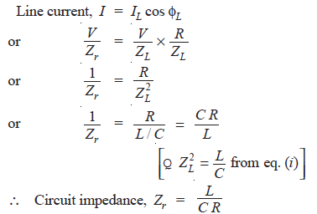
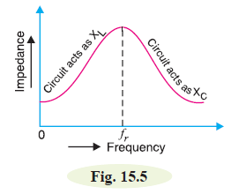
Transistor Tuned Amplifiers
Thus at parallel resonance, the circuit impedance is equal to L/CR.
It may be noted that $Z_{r}$ will be in ohms if R, L and C are measured in ohms, henry and farad respectively.
Notes:
aaa

Slide 12
Transistor Tuned Amplifiers
(ii) Circuit Current.
At parallel resonance, the circuit or line current I is given by the applied voltage divided by the circuit impedance $Z_{r}$ i.e.,
Because $Z_{r}$is very high, the line current I will be very small.
Notes:
aaa

Slide 13
Transistor Tuned Amplifiers
(iii) Quality factor Q.
It is desired that resonance curve of a parallel tuned circuit should be as sharp as possible in order to provide selectivity.
The sharp resonance curve means that impedance falls rapidly as the frequency is varied from the resonant frequency.
The smaller the resistance of coil, the more sharp is the resonance curve. This is due to the fact that a small resistance consumes less power and draws a relatively small line current.
The ratio of inductive reactance and resistance of the coil at resonance, therefore, becomes a measure of the quality of the tuned circuit.
This is called quality factor and may be defined as under :
Notes:
aaa

Slide 14
Transistor Tuned Amplifiers
The ratio of inductive reactance of the coil at resonance to its resistance is known as **quality factor Q i.e.,
The quality factor Q of a parallel tuned circuit is very important because the sharpness of resonance curve and hence selectivity of the circuit depends upon it.
The higher the value of Q, the more selective is the tuned circuit.
Fig. 15.6 shows the effect of resistance R of the coil on the sharpness of the resonance curve.
Notes:
aaa

Slide 15
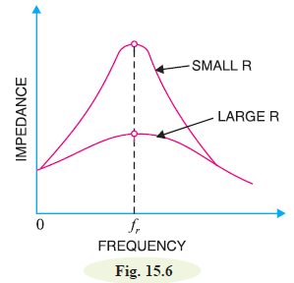
Transistor Tuned Amplifiers
It is clear that when the resistance is small, the resonance curve is very sharp.
However, if the coil has large resistance, the resonance curve is less sharp.
It may be emphasized that where high selectivity is desired, the value of Q should be very large.
Notes:
aaa

Slide 16
Transistor Tuned Amplifiers
Example 15.1. A parallel resonant circuit has a capacitor of 250pF in one branch and inductance of 1.25mH plus a resistance of 10Ω in the parallel branch. Find (i) resonant frequency (ii) impedance of the circuit at resonance (iii) Q-factor of the circuit.
Solution.
R = 10Ω ; L = 1.25 × ${10}^{−3}$H; C = 250 × ${10}^{−12}$ F
Notes:
aaa

Slide 17
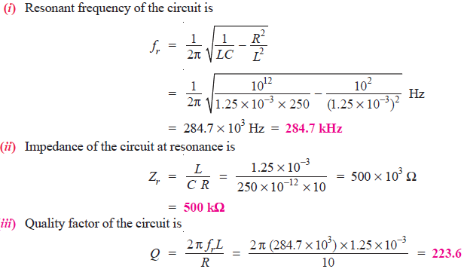
Transistor Tuned Amplifiers
Notes:
aaa

Slide 18
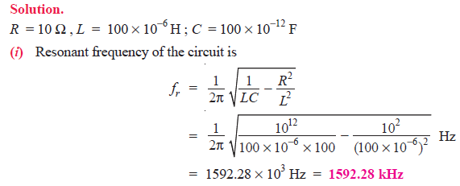
Transistor Tuned Amplifiers
Example 15.2. A parallel resonant circuit has a capacitor of 100 pF in one branch and inductance of 100 μH plus a resistance of 10 Ω in parallel branch. If the supply voltage is 10 V, calculate (i) resonant frequency (ii) impedance of the circuit and line current at resonance.

Slide 19
Transistor Tuned Amplifiers

Slide 20
Transistor Tuned Amplifiers
Advantages of Tuned Amplifiers
Small power loss. A tuned parallel circuit employs reactive components L and C. Consequently, the power loss in such a circuit is quite low. On the other hand, if a resistive load is used in the collector circuit, there will be considerable loss of power. Here fore, tuned amplifiers are highly efficient.
(ii) High selectivity. A tuned circuit has the property of selectivity
i.e. it can select the desired frequency for amplification out of a
large number of frequencies simultaneously impressed upon it.
For instance, if a mixture of frequencies including fr is fed to
the input of a tuned amplifier, then maximum amplification
occurs for fr.
20

Slide 21
Transistor Tuned Amplifiers
For all other frequencies, the tuned circuit offers very low impedance and hence these are amplified to a little extent and may be thought as rejected by the circuit. On the other hand, if we use resistive load in the collector, all the frequencies will be amplified
equally well i.e. the circuit will not have the ability to select the desired frequency.
(iii) Smaller collector supply voltage. Because of little resistance in the parallel tuned circuit, it requires small collector supply voltage VCC. On the other hand, if a high load resistance is used in the collector for amplifying even one frequency, it would mean large voltage drop across it due to zero signal collector current. Consequently, a higher collector supply will be needed.

Slide 22
Transistor Tuned Amplifiers
Frequency Response of Tuned Amplifier
The voltage gain of an amplifier depends upon β, input impedance and effective collector load. In a tuned amplifier, tuned circuit is used in the collector. Therefore, voltage gain of such an amplifier is given by :

Slide 23
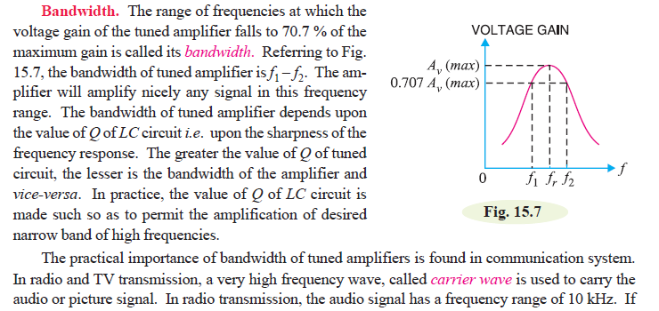
Transistor Tuned Amplifiers

Slide 24
Transistor Tuned Amplifiers
Relation between Q and Bandwidth
The quality factor Q of a tuned amplifier is equal to the ratio of resonant frequency (fr) to bandwidth (BW) i.e.,
The Q of an amplifier is determined by the circuit component values. It may be noted here that Q of a tuned amplifier is generally greater than 10. When this condition is met, the resonant frequency At parallel resonance is approximately given by:

Slide 25
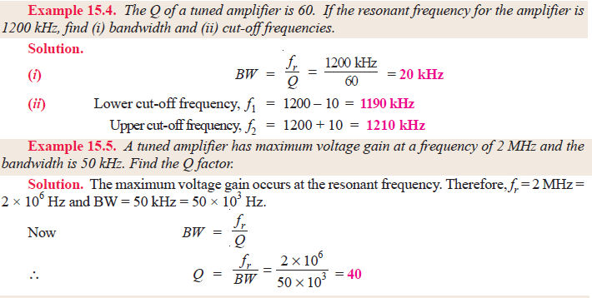
Transistor Tuned Amplifiers

Slide 26
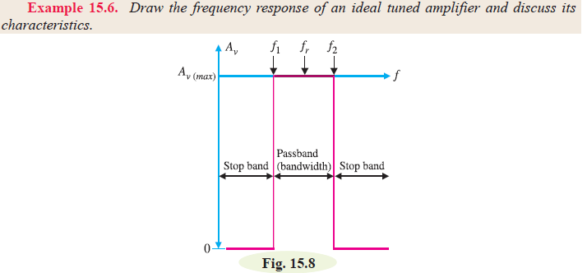
Transistor Tuned Amplifiers

Slide 27
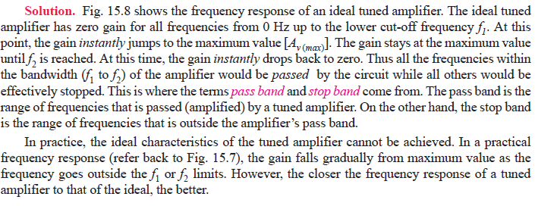
Transistor Tuned Amplifiers

Slide 28
Transistor Tuned Amplifiers
Types of Tuned Amplifier
1. Single tuned 2. Double tuned & 3. Stagger tuned

